Slide 1
Home work 1
QA

Slide 2
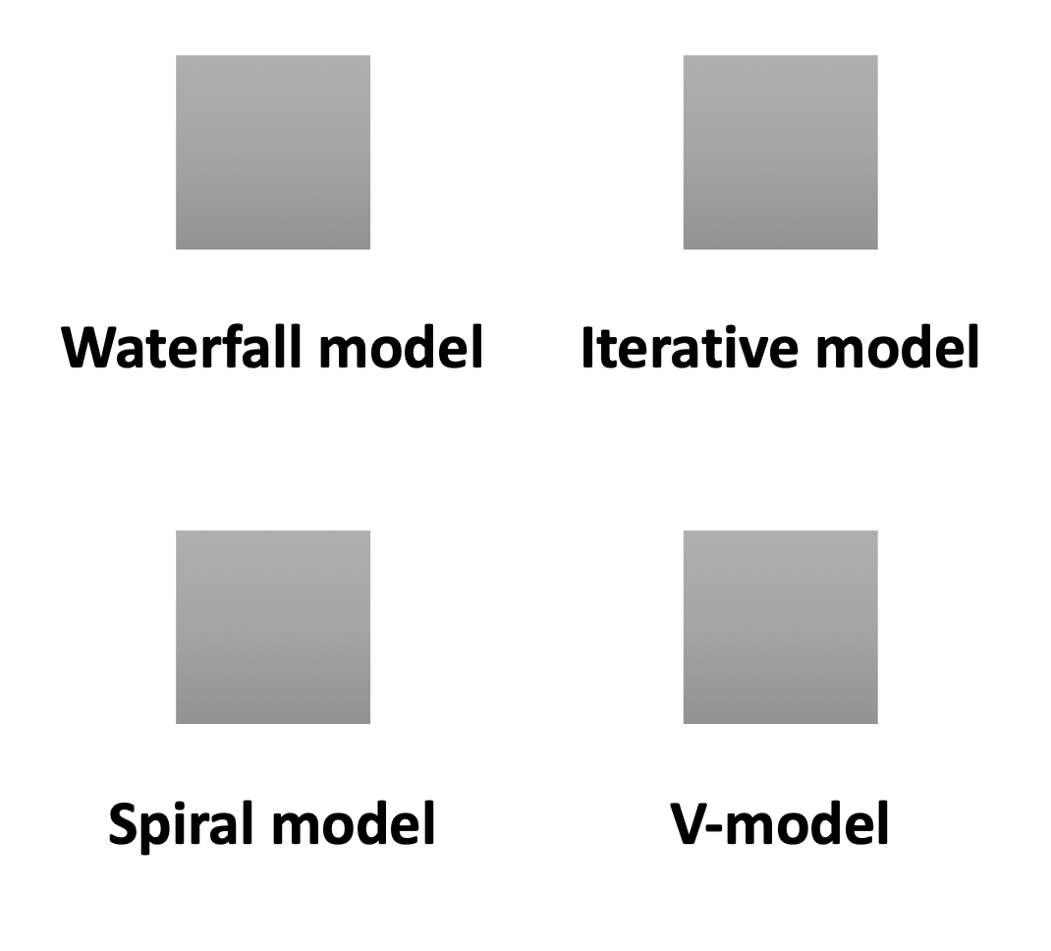
Software Development lifecycle models

Slide 3
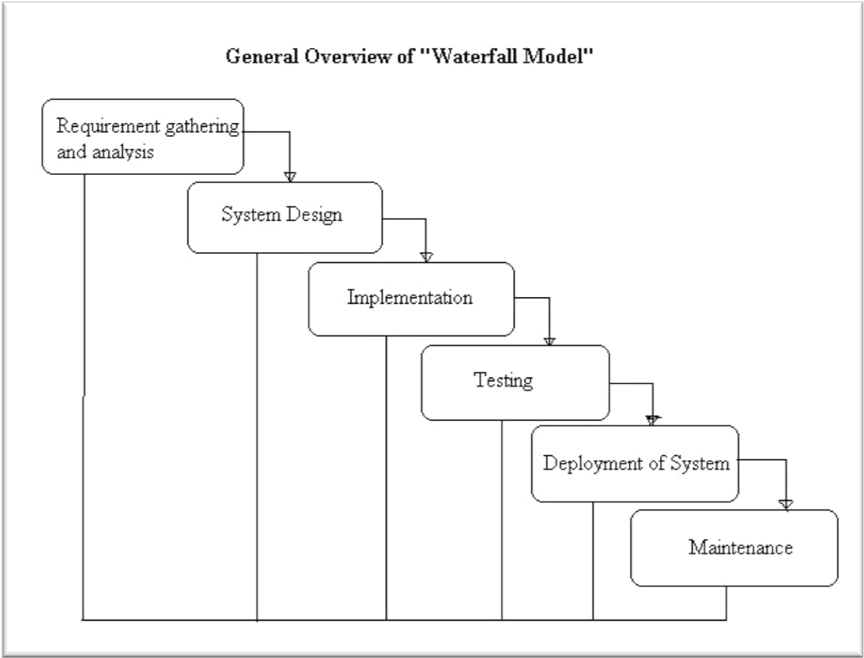
Waterfall model

Slide 4
WATERFALL MODEL
WATERFALL MODEL involves a single implementation of each of the phases of the project, which, in turn, strictly follow each other.
IN WATERFALL MODEL Testing occurs from the middle stage of the project development and reaching it's maximum in the end of the project.

Slide 5
ADVANTAGES | DISADVANTAGES
This model is simple and easy to understand and use. It is easy to manage due to the rigidity of the model each phase has specific deliverables and a review process. In this model phases are processed and completed one at a time. Phases do not overlap. -Waterfall model works well for smaller projects where requirements are clearly defined and very well understood. | Once an application is in the testing stage, it is very difficult to go back and change something that was not well-thought out in the concept stage. No working software is produced until late during the life cycle. High amounts of risk and uncertainty. Not a good model for complex and object-oriented projects. Poor model for long and ongoing projects. Not suitable for the projects where requirements are at a moderate to high risk of changing.
WATERFALL MODEL

Slide 6

ITERATIVE MODEL
Testing occurs from the beginning of life cycle of the project.
Development begins by specifying and implementing just part of the software (design, implement, analysis), which can then be reviewed in order to identify further requirements. This process is then repeated, producing a new version of the software for each cycle of the model.

Slide 7
Advantages | Disadvantages
In iterative model we are building and improving the product step by step. Hence we can track the defects at early stages. This avoids the downward flow of the defects. In iterative model we can get the reliable user feedback. When presenting sketches and blueprints of the product to users for their feedback, we are effectively asking them to imagine how the product will work. In iterative model less time is spent on documenting and more time is given for designing. The iterative model has proven itself very well on large and complex projects performed by large teams over long periods of time. | Each phase of an iteration is rigid with no overlaps Costly system architecture or design issues may arise because not all requirements are gathered up front for the entire lifecycle
Iterative model

Slide 8
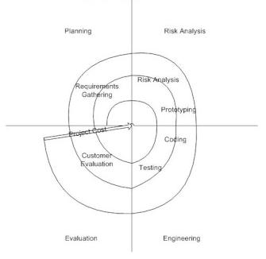
Spiral model

Slide 9
Spiral Model
The SPIRAL MODEL is similar to the incremental model, with more emphasis placed on Risk analysis.
The key phases of PIRAL MODEL:
Planning phase
Risk Analysis
Engineering phase
Evaluation phase

Slide 10
Advantages | Disadvantages
High amount of risk analysis hence, avoidance of Risk is enhanced. Good for large and mission-critical projects. Strong approval and documentation control. Additional Functionality can be added at a later date. Software is produced early in the software life cycle. | Can be a costly model to use. Risk analysis requires highly specific expertise. Project’s success is highly dependent on the risk analysis phase. Doesn’t work well for smaller projects.
SPIRAL model

Slide 11
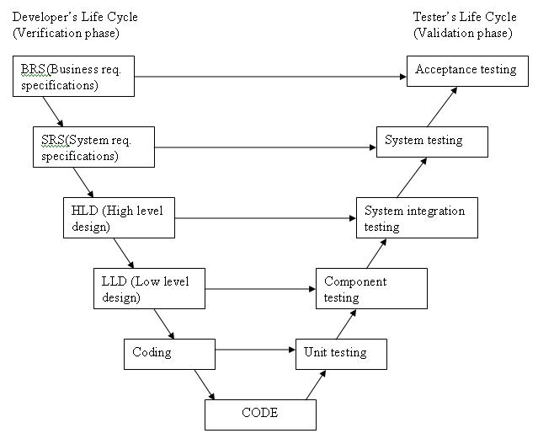
V-MODEL

Slide 12
V Model
In V-MODEL Testing appears here at the earliest stages of the project development.

Slide 13
Advantages | Disadvantages
Simple and easy to use. Testing activities like planning, test designing happens well before coding. This saves a lot of time. Proactive defect tracking – that is defects are found at early stage. Avoids the downward flow of the defects. Works well for small projects where requirements are easily understood. | Very rigid and least flexible. Software is developed during the implementation phase, so no early prototypes of the software are produced. If any changes happen in midway, then the test documents along with requirement documents has to be updated.
V- model

